Slide 1
Level 5 & 6 Information Evening
Term 1, 2025
Grade 5 - Linda Bett, Chris Young, Ilana Tusia
Grade 6 – Riena Astuti, Simon Judkins
Educational Support - Chrissie Sandford-Ricci, Fiona Schwass, Andy Pullar, Jo Hewett, Sienna Bett

Slide 2
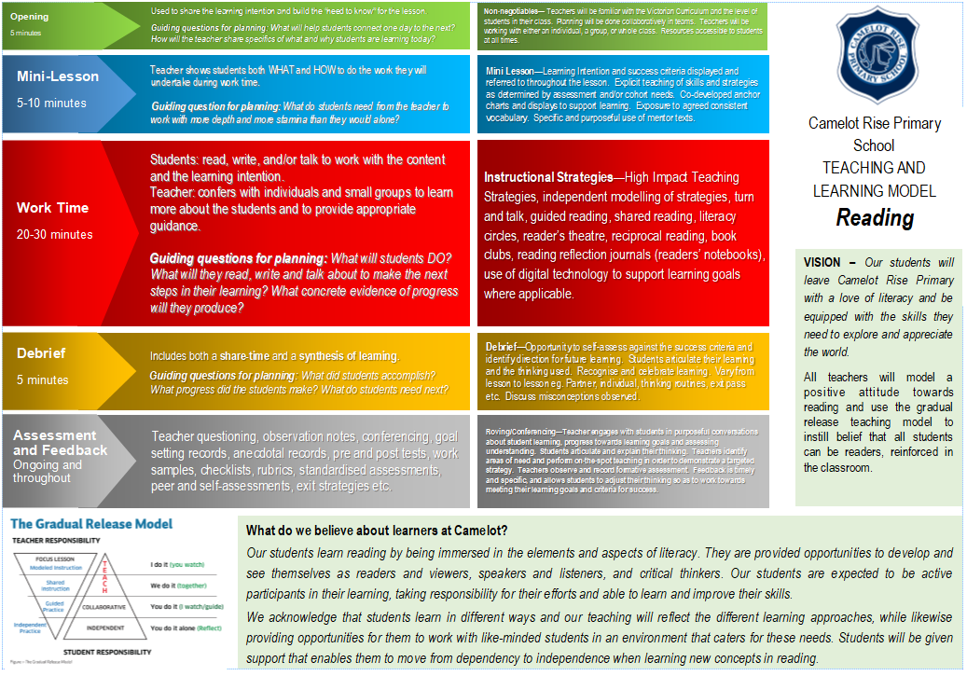
Notes:
Linda

Slide 3
Notes:
Linda

Slide 4
Reading and viewing
All lessons follow the CRPS Instructional Model and Gradual Release of Responsibility
Students’ reading will improve through opportunities to regularly read books of their choice.
The teacher will regularly meet with different students and focus on core reading comprehension strategies. This will be done in either small groups or individually.
A part of reading in Level 5/6 is being able to work in small groups focusing on text analysis, comprehension and independent reading.
Students are taught to monitor and track their thinking in different ways. They will be encouraged to use their Reader’s Notebooks to capture their responses.
Notes:
Linda

Slide 5
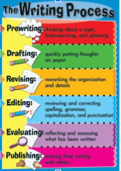
How we teach writing All lessons follow the CRPS Instructional Model and Gradual Release of Responsibility
Methods of instruction:
Modelled writing
Shared writing
Conferencing
Purpose for writing:
to entertain
to persuade
to inform/explain
Writer’s Notebooks
Writing seeds and ideas
The writing process:
Pre-writing
Drafting
Revising
Editing
(Evaluate)
Publishing
Handwriting Spelling/Word study Grammar
Notes:
Linda

Slide 6
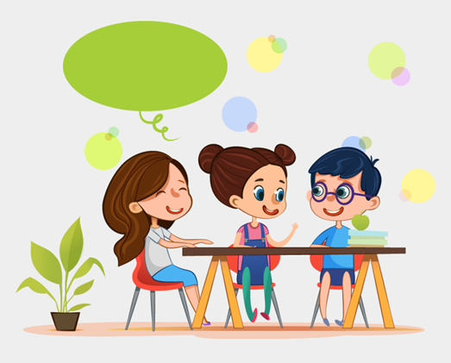
Speaking & Listening
Opportunities:
Conferencing
Whole class/small group discussions
Circle time
Small collaborative group work
Formal and informal presentations
Pair discussions
Notes:
Linda

Slide 7
Mathematics
All lessons follow the CRPS Instructional Model and Gradual Release of Responsibility
Across Level 5/6:
Essential Assessments – pre/post testing
Maths classes change throughout the year depending on each student’s point of need across the different areas of mathematics. This means that the concepts being taught match each student’s needs and are grouped with other like-minded students
Students work in a variety of ways - aiming to build upon all 4 areas of mathematical thinking: understanding, fluency, reasoning and problem solving
Use a variety of hands on materials
Mathletics
Notes:
Simon

Slide 8
Differentiation Example
This is a Year 5/6 example:
Learning Focus - Number and Place Value
Group 1 - Working with numbers beyond one hundred thousands
Group 2 - Working with numbers with decimals
Group 3 - Factors, Multiplies, Squares, Cubes
Group 4 - Integers, Index notation to express numbers
Fluid groups based on individual assessments.
Notes:
Simon

Slide 9
Digital Devices
What DT with devices looks like at Level 5/6:
Safe computer usage – including Cyber Safety and how to use different types of technology safely
All computer usage at school is supervised and structured to enhance student learning
Learning to use a range of devices, including netbooks and iPads
Learning how to create, store, save and retrieve files correctly in a variety of spaces, including Office365 and MS Teams
Using Microsoft Office programs (e.g. Word, PowerPoint, Publisher and Excel) to present ideas and learning
Developing research skill with the use of technology
A note about phones and watches
Notes:
Simon

Slide 10
Digital Technologies
What DT looks like at Level 5/6
Code.org – blocky code, extending into python where necessary
Spheros and drones
Green screen and image editing
Design and technology – engineering and mathematics concepts
Cybersafety
Notes:
Simon

Slide 11
Seesaw
This is our student to parent communication portal.
Students share snapshots of their work throughout the year, covering a variety of subjects and classes.
If you aren’t already connected to Seesaw, you will get an email shortly asking you to join seesaw. Once you do this, you will be able to see any work your child has added. You will be able to leave a comment for them, if you wish.
Once signed up, you will receive an email whenever something new gets posted.
You can expect 4-5 pieces of work per term.
Notes:
Simon

Slide 12
Notes:
Caroline

Slide 13
CRPS Whole School Wellbeing Program
Buddies, Lunchtime activities, Wellbeing captains, SWAT.
Schoolwide wellbeing programs:
Respectful relationships - government initiative
Resilience Project
Schoolwide positive behaviours
Restorative Practice
Also factored in are:
Class meetings
Behaviour matrix
School values - Respect, Responsibility, Resilience
Class and schoolwide rewards
Notes:
Caroline

Slide 14
Homework
The Homework expectations for students in Levels 5 and 6
Homework will be set on Monday and due on the following Monday. On Monday morning, diaries will be reviewed in class for each student’s completion of the following:
Reading - 30 mins 4 times a week recorded in the diary. Each reading session must be accompanied with at least 1 sentence related to the book
Maths - weekly tasks (sheet or online activities)
Wellbeing - weekly activities set in Diary (optional)
Please ensure diaries are signed by a parent/carer.
Notes:
Caroline

Slide 15
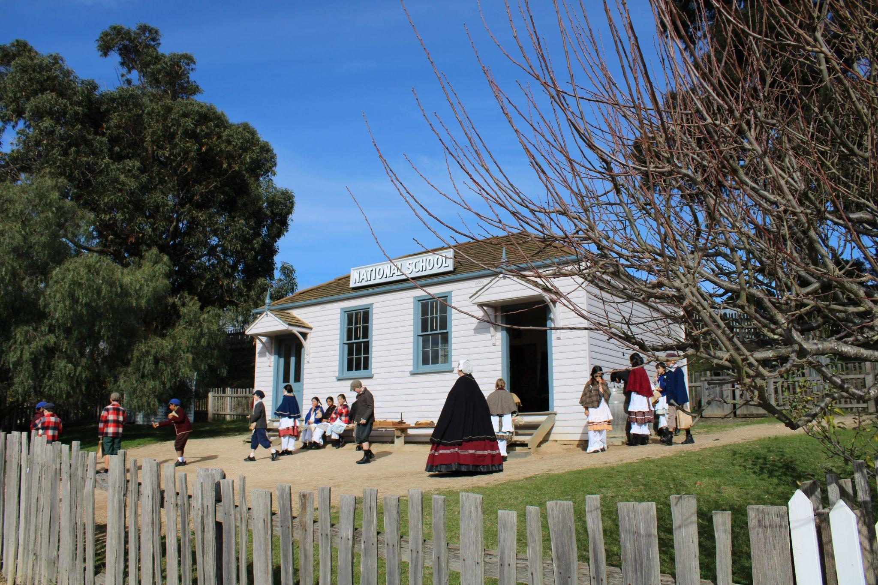
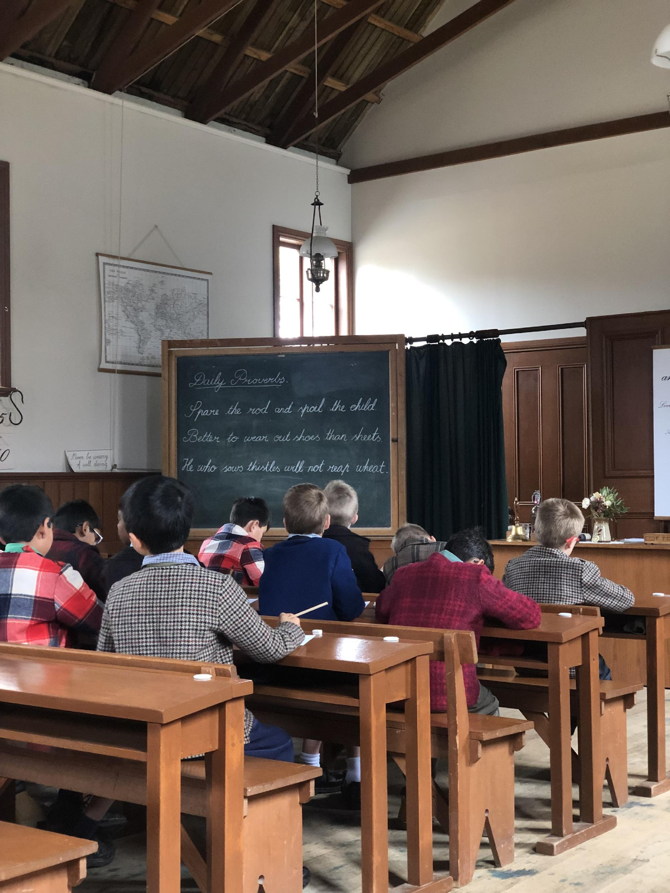
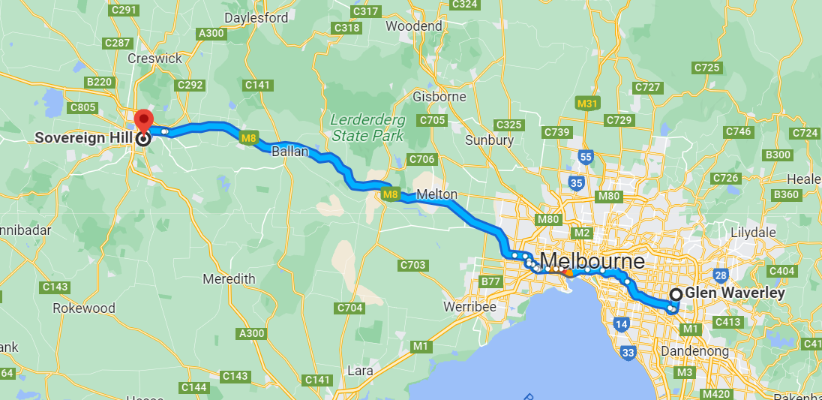
Year 5 Camp
Camps
Year 5 Sovereign Hill Camp: 21st – 23rd May
Notes:
Ilana

Slide 16
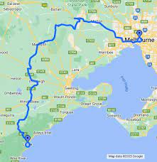
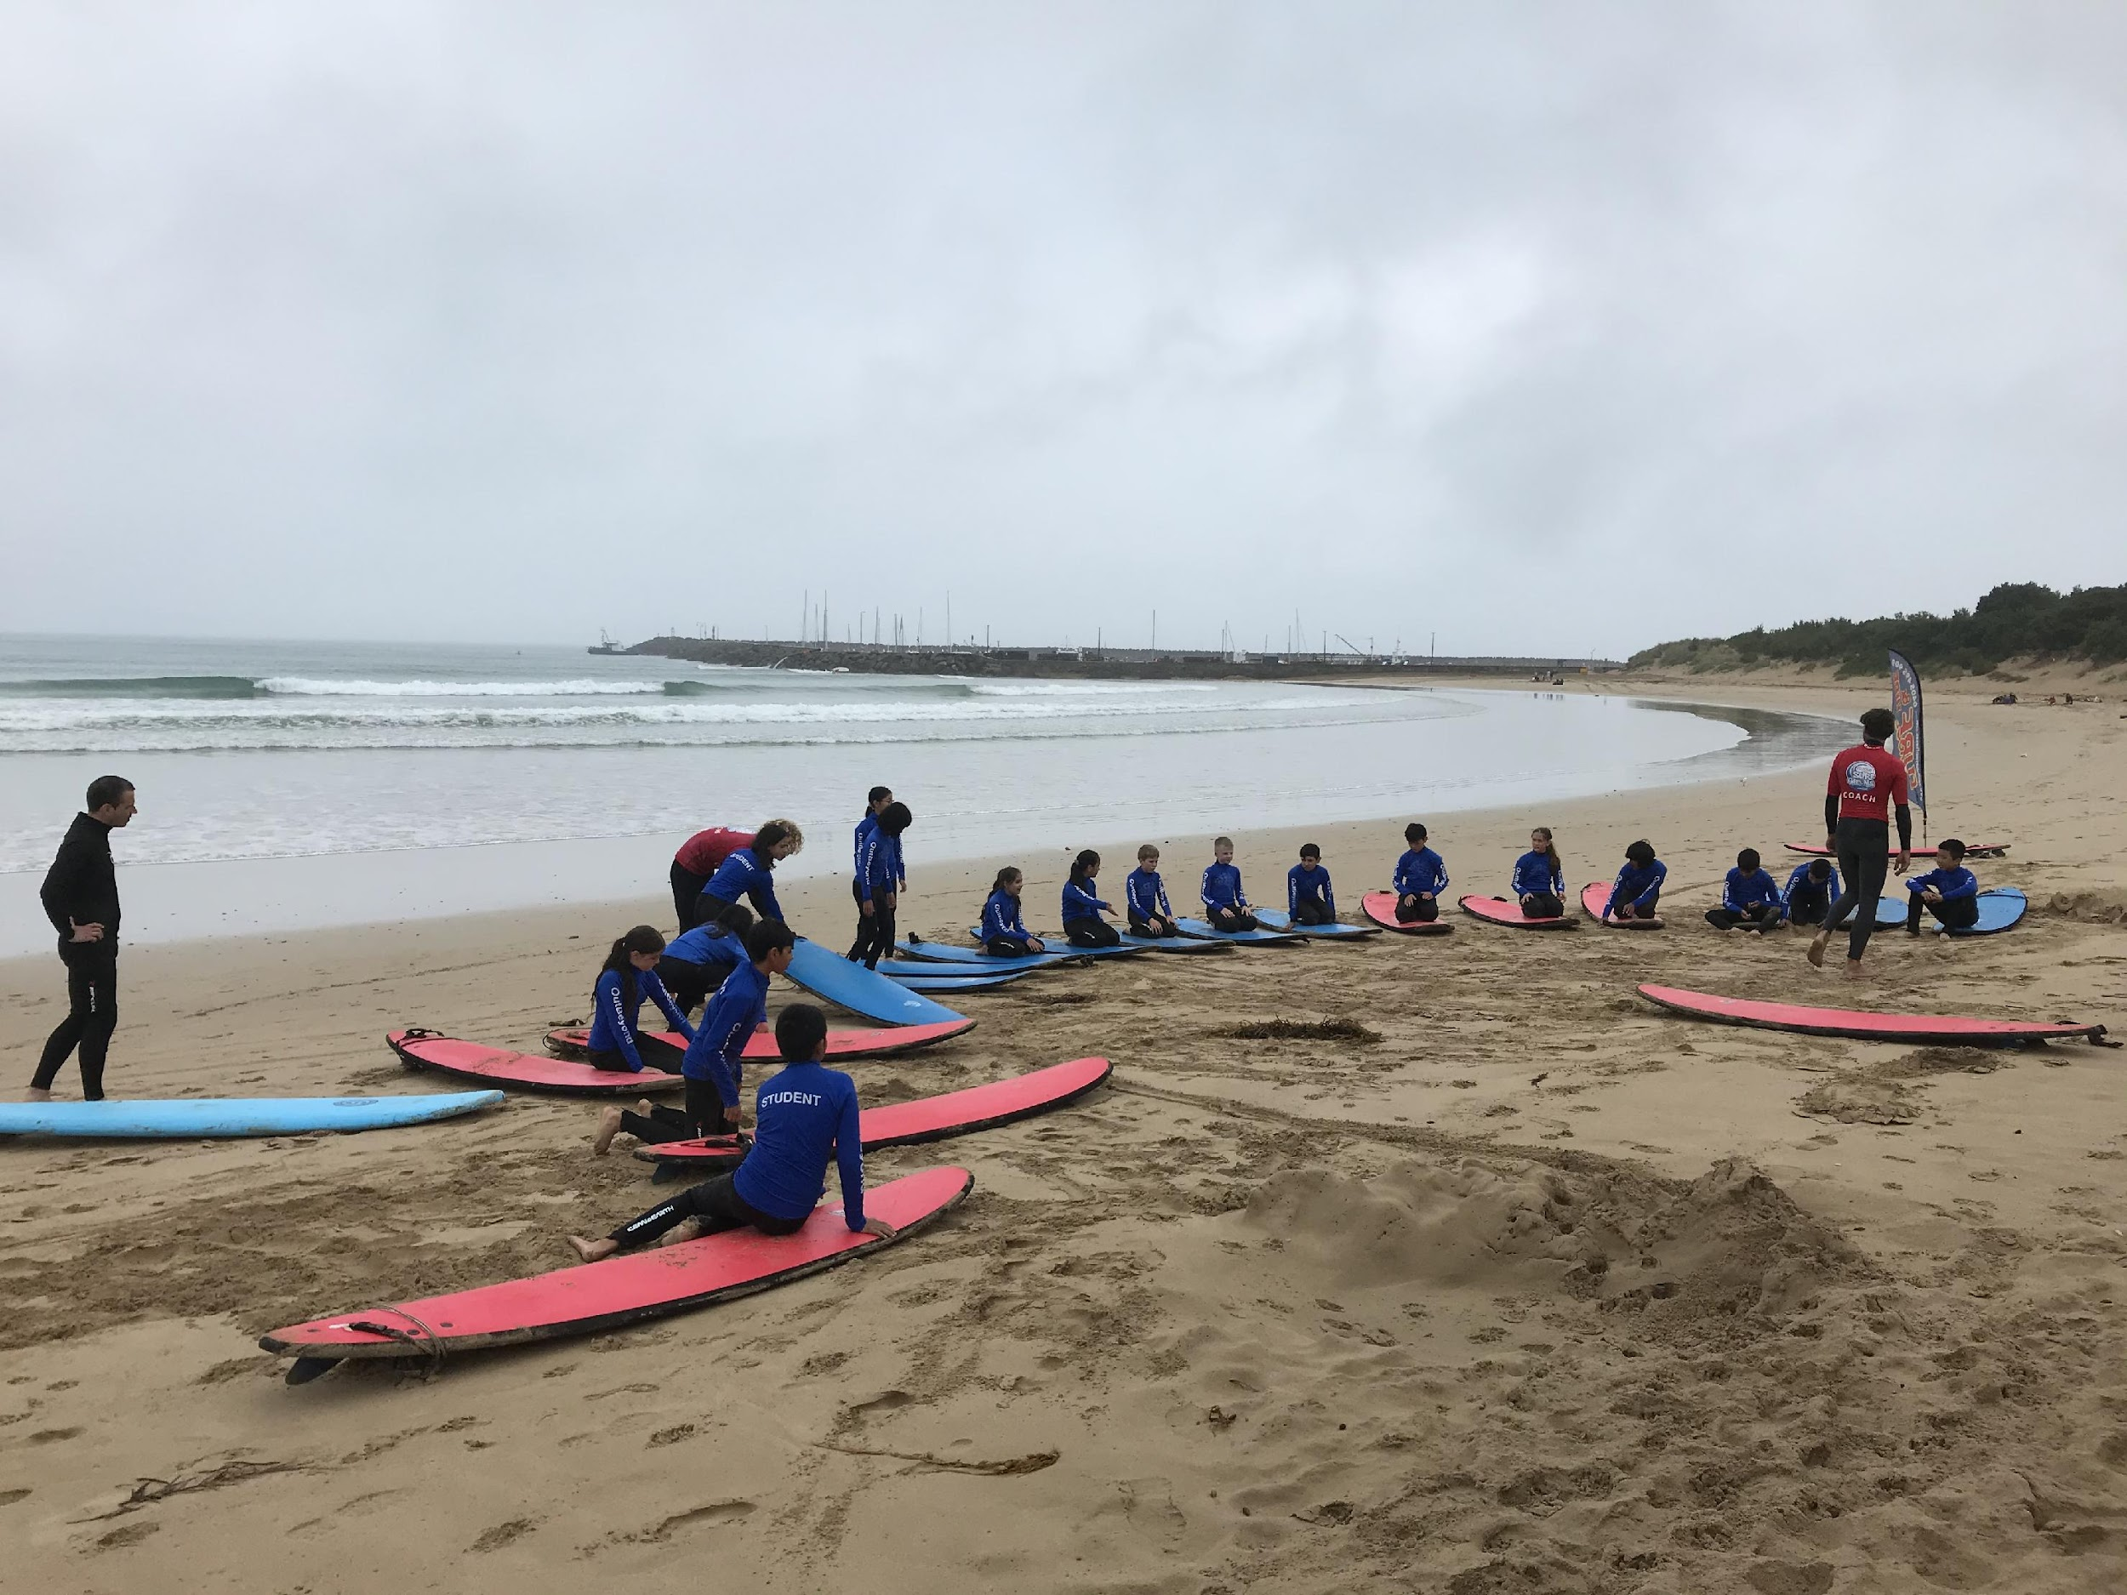
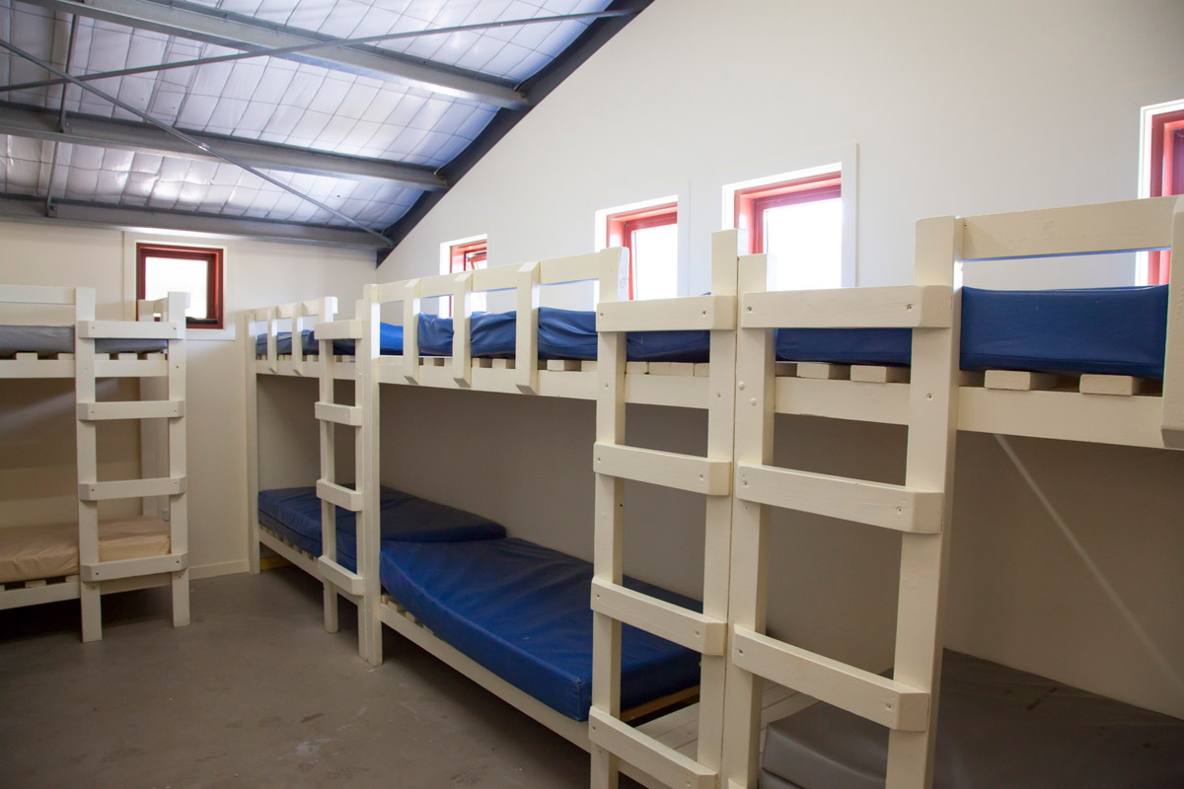
Year 6 Camp
Camps
Year 6 Lorne Surf Camp: 17th – 21st March
Notes:
Ilana

Slide 17
Important Dates - Term 1
Getting to Know You Interviews - Thursday 6th Feb
Intra school Swimming – 5th Feb (selected students)
District Swimming – 13th Feb (selected students)
Student Leader Badge Presentation - 21st Feb
Interschool Sport – 14th Feb, 21st Feb, 14th March, 28th March (Grade 6 students)
GRIP Leadership Conference – 4th March (selected students)
NAPLAN – Wed 12th March – 14th March (grade 5 students)
Twilight Sports - Thu 3rd April

Slide 18
What?
During 2015 CRPS is implementing a staged release of our new school management software, Compass School Manager.
Throughout the coming year, we plan to release other features which will allow you to:
Access your child's semester reports
Access your child's progress reports (year 2)
Download, print and approve upcoming excursion/incursion forms
Pay school fees, charges and contributions online
Update your registered email and mobile number
Access information regarding upcoming events and news and lots more
Email your child’s teacher
Compass
We use Compass as a means of communication between classroom teachers and parents.
If you would like any further information about Compass, see the Office.
Please check Compass regularly for upcoming events and to log absences.
The School Newsletter is available from the school website and via the notification on Compass.
Notes:
Ilana

Slide 19
Parent Representatives
Helps foster communication within the school community
Class or Year Level Representative (volunteer) to compile a family contact list (opt-in participation), organise family activities out of school hours, providing reminders to parents of any upcoming events and promoting communications between school and parents.
Working with Children Check (receipt accepted)
Notes:
Ilana

Slide 20
Encouraging your child to be independent.
Develop their organisation skills by using a diary.
In preparation for camp, pack their own bag and be responsible for what items are included in their bag.
Mobile phones/smart watches that can be used as phones must be checked into the safe at 8:50am and they can be collected at the end of the day.
Get to school on time at 8.45. The school grounds are unsupervised before 8:45 am and after 3.45 pm.
Notes:
Ilana

Slide 21
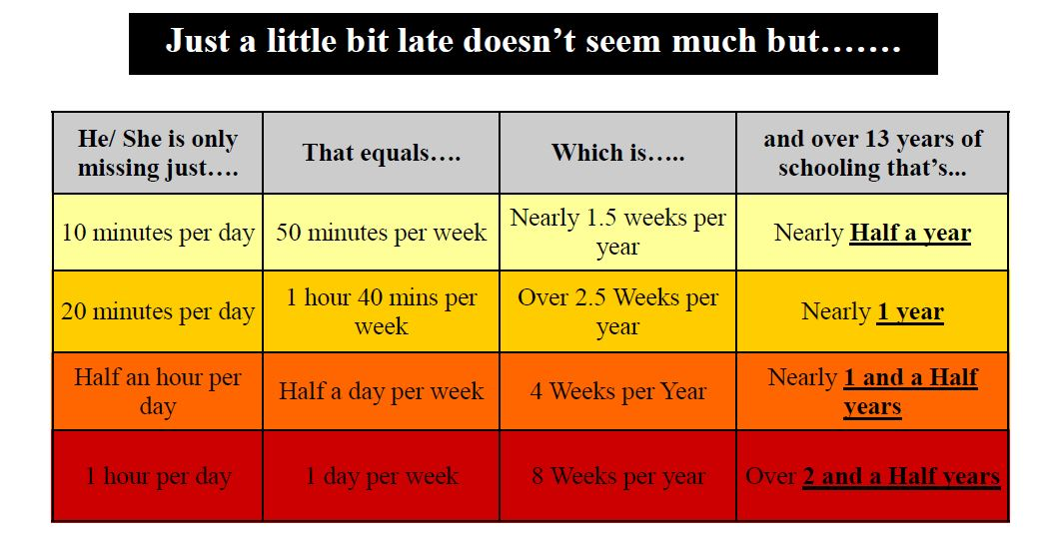
Attendance is important for your child's learning
Notes:
Ilana

Slide 22
Specialist Programs
French Christine D’Souza
Physical Education and Sport Cameron Stillman
Visual Arts Sharyn Newstead
Performing Arts Debra Hong
STEM - Lorna Vinar
Notes:
Ilana

Slide 23
STEM with Mrs Lorna Vinar
For Level 5/6 in STEM the program will operate on a 2-year cycle. This year the students will cover Physical Sciences and Earth and Space Sciences. Next year the program will cover the Chemical and Biological Sciences.
• Throughout the year students will discuss their hypothesis and the aim of experiments and identify independent and dependent variables.
• Students will share how an experiment could be improved and factors that may have an impact on the results of an experiment.
• Students will use technology during experiments and apply mathematics skills they have learnt in class.
• In term 1 students will learn the parts of the human eye. They will investigate light energy the difference between opaque, translucent and transparent objects. Refraction and reflection of light will also be investigated.
• In term 2 students will discover the components of electrical circuits and build electrical circuits. Students will also explore energy transformations.
• In term 3 students will investigate the earth and its place in the solar system.
• In term 4 students will learn about some techniques in forensic science such as fingerprinting and handwriting analysis.

Slide 24
Performing Art with Ms Debra Hong
PA encompasses Music, Dance and Drama. Students perform, create and respond as performers and audience. In Music they engage in listening and singing a range of genres, body percussion, and use an assorted tuned and untuned instruments. They look at elements such as: beat, rhythm, pitch, dynamics, tempo, texture, form, harmony and melody, and read and compose using formal notation. In Drama students act impromptu and with short plays, and in Dance choreograph routines. Notable events include the Soiree and Christmas Concert. Students from 3-6 may join the Choir which meets on Friday during the 1st half of lunch time.

Slide 25
Visual Art with Mrs Sharyn Newstead
Students explore how artists, craftspeople, and designers bring ideas to life through various visual forms and processes, developing both conceptual and expressive skills. Through creating and responding to visual artworks, students explore a variety of ideas, concepts, and perspectives. They draw inspiration from other artists, artworks, symbolic systems, beliefs, and visual arts practices across different cultures, societies, and time periods. They further develop a range of skills across a variety of media, including pencil, paint, clay and textiles. Please ensure all students have a named art smock.

Slide 26
PE with Mr Cam Stillman
The Year 5 and 6 P.E. program is designed around three key areas:
1. Moving the Body
2. Understanding Movement
3. Learning through Movement
At this stage of their development, students continue to consolidate their skills and knowledge across sports and games. Each unit focuses on a specific sport, progressing from skill development to understanding the rules and strategies, and ultimately to playing modified or standard games.
Fitness assessments in Terms 2 and 4 are a significant part of the curriculum, allowing students to assess their results, and reflect on their health and well-being, in preparation for Cross Country and Athletics events.

Slide 27
PE with Mr Cam Stillman
Throughout the year, students have opportunities to take on different roles and responsibilities. They develop their communication skills and problem-solving abilities within team and group settings.
A central focus is fostering sportsmanship and encouraging healthy, respectful competition, where students learn to embrace both winning and losing. The Year 6 interschool sports competitions offer a valuable chance for students to apply these skills in a competitive environment.
There are numerous opportunities for students to participate in sporting events:
• Cross Country
• Athletics
• Interschool Sports (Summer & Winter)
• Interschool Swimming
All the above sports can proceed to Division, Region, and State levels.

Slide 28
French with Mrs Christine D’Souza
In their French classes, students work equally on their speaking, listening, reading and writing skills, just as they do in their English classes. This term students are learning to describe people, which includes physical descriptions (hair and eyes) and clothing. The first few minutes of every class is spent revising standard questions like name, age, where you live, the date and the weather as well as beginning to apply current topics in partner conversations. This is designed to allow all students to experience success and to develop confidence with the language through repetition.
Written work adds the dimension of reading and writing to complement the oral and aural components.
A variety of formats is used to present content in order to reinforce concepts on the one hand and to create and maintain interest and motivation on the other.

Slide 29
Thank you
If you have any questions please contact your child’s teacher.

