Slide 1
Level 1/2 Information Evening Term 1, 2025
Tennille Giannopoulos and Mary Katsigiannis 1G
Karen Watts 1K
Sarah Woods (Team Leader) 1S
Stephanie Johnson & Peta Rose 2JR
Lauren Gabriele 2G
Julie Shepherd 2S
Andy Puller, Chrissie Sandford-Ricci, Jo Hewett, Fiona Schwass and Sienna Bett (ES staff)

Slide 2
Quality Beginnings
In our first week of school we set up our learning community in our classroom. This involved:
Classroom expectations
Morning and afternoon routines
Understanding how we learn
Learning about each other
Developing friendships
The new Victorian Learning Model - (attention/focus/regulation/knowledge/memory/
retention/recall/mastery/application)
Notes:
Tennille

Slide 3
What?
During 2015 CRPS is implementing a staged release of our new school management software, Compass School Manager.
Throughout the coming year, we plan to release other features which will allow you to:
Access your child's semester reports
Access your child's progress reports (year 2)
Download, print and approve upcoming excursion/incursion forms
Pay school fees, charges and contributions online
Update your registered email and mobile number
Access information regarding upcoming events and news and lots more
Email your child’s teacher
Compass
We use Compass as a means of communication between classroom teachers and parents.
If you would like any further information about Compass, see the Office.
Please check Compass regularly for
upcoming events and to log absences
School Newsletter - available from school website and notification on Compass.
Notes:
Tennille

Slide 4
CURRICULUM
How we teach Reading
Vision: At CRPS we want students to develop a love of literacy and to be equipped with the skills they need to explore and appreciate their world. This is one of the most important parts of your child's learning in lower primary. We really help foster their love of learning and believe that the most important thing your child can do at home with their parents is to read, read and read some more!
At school we focus on:
5 hours of reading lessons per week
Explicit instruction of reading skills and strategies as a whole class, small group or individually
Examples of Methods of Instruction
Modelled reading
Shared reading
Teacher focus groups (eg. Guided reading)
Conferencing – individual goal setting
Independent reading
Buddy reading
Notes:
Karen

Slide 5
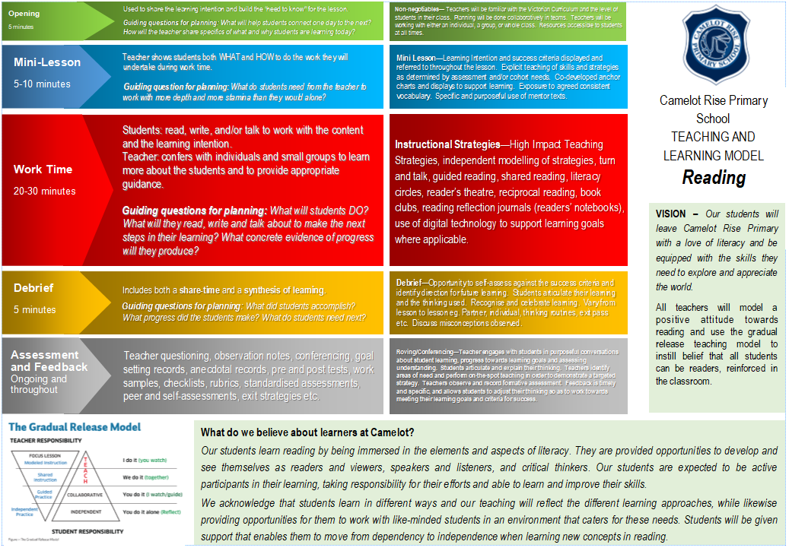
Notes:
Karen

Slide 6
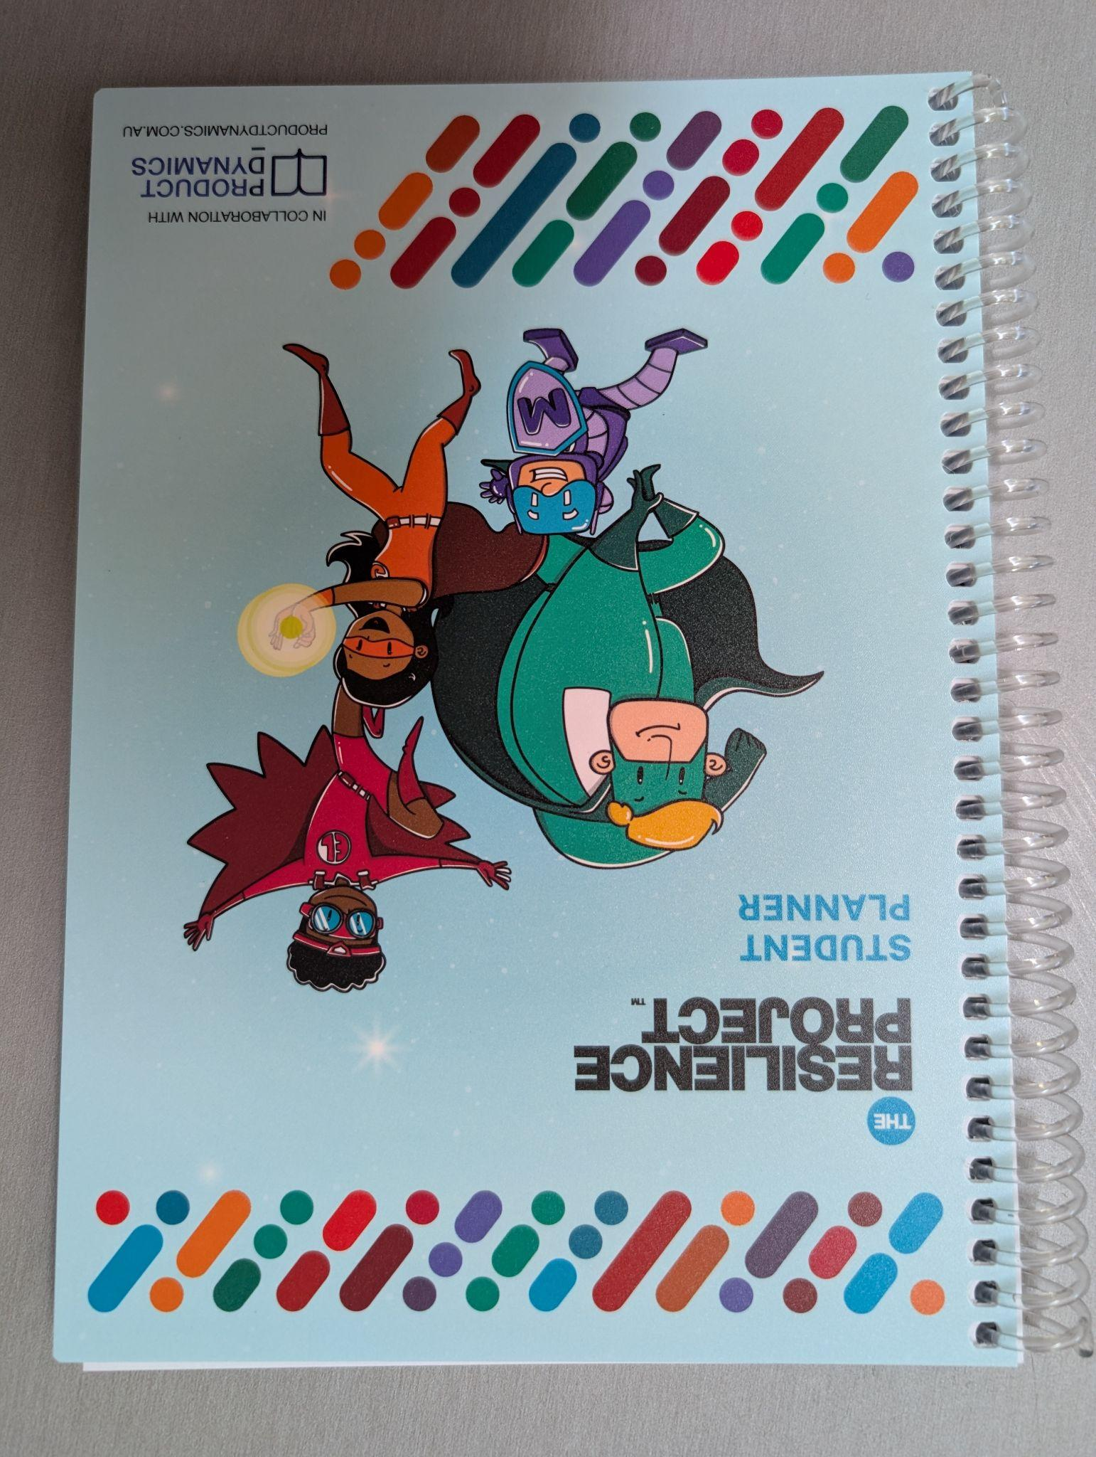
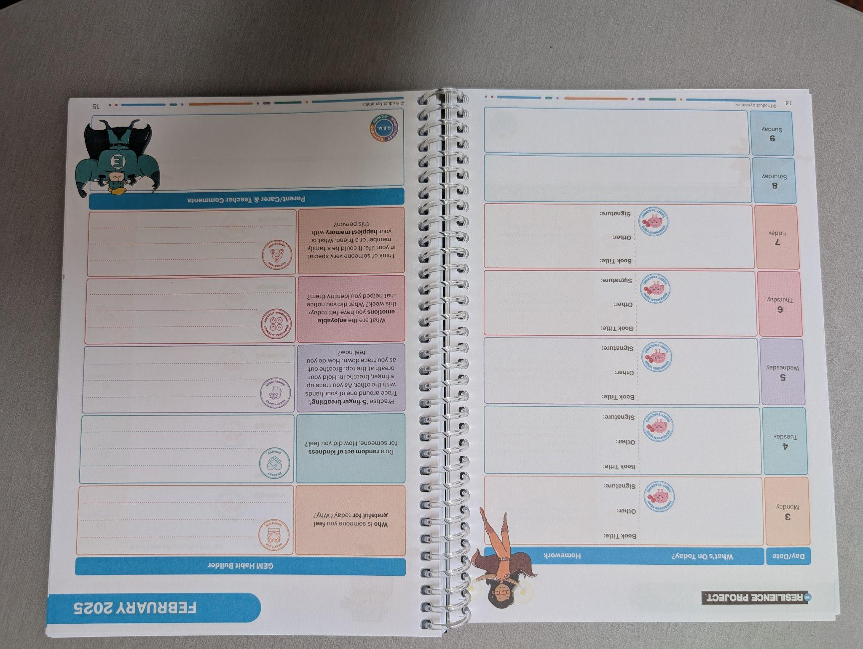
Homework
The Homework expectations for students in Levels 1 and 2 are:
Reading each night (recorded in Resilience Project Student Planner)
Participation in the Talk, Listen, Learn program - these topics usually change each term.
Notes:
Karen
Discuss teacher signature in journal, discuss examples of TLL and remind parents to help their child rehearse at home, discuss our expectations

Slide 7
How we teach Writing
Ralph Fletcher: “We need to set up a community of writers who write from their heart and their head.”
•In the classroom:
•They will use a Writer’s Notebook to help with writing ideas
•We will use a Writing process: planning, drafting, revising and sometimes publishing
•Some texts may be worked on for several sessions
•Writing conventions will be taught in context
•We will examine many different writing forms
Notes:
Julie

Slide 8
How we teach Spelling
We will teach students spelling throughout the week through inquiry (working out the meaning, the parts, history and sounds).
We use tools such as word sums and matrices to help us learn the spelling of new words.
Spelling will be differentiated and taught to students to support them at their point of need.
Notes:
Julie

Slide 9
Different writing elements 5 hours of writing lessons per week - minimum
Methods of instruction:
Modelled writing
Shared writing
Conferencing
Purposes for writing:
to entertain
to persuade
to inform/explain
to transact
Language Experience
Oral language - EAL (language experience)
0 Writer’s Notebook
The writing process:
Brainstorm/Plan
Draft
Revise
Edit
Publish
Notes:
Julie

Slide 10
Speaking & Listening
Classroom and Specialist opportunities:
Shared reading (whole class)
Buddy Reading
Conferencing
Whole class/small group discussion
Circle time
Class Meetings
Small group work
Formal upfront presentations
Pair discussion/Talking Buddies
Talk, Listen and Learn
Notes:
Sarah

Slide 11
Maths
Across Level 1/2
5 hours of maths lessons per week
We follow our Teaching and Learning Model when teaching Maths
Maths concepts are taught at the students’ point of need
All students are extended according to assessments
Students work in a hands-on way with a variety of materials
Students to see links between different areas of the curriculum
Essential Assessments – Pre/Post testing
We used this data to form teaching focus groups and to plan for Teaching and Learning in PLTs
Mathletics
Notes:
Lauren

Slide 12
Inquiry
Term 1 – Identity: Who am I?
Students will explore these key concepts:
It is important to know our personal strengths
Everyone is unique and we need to accept each other
We all belong to different groups
Each of us has a different family and cultural history
There are skills we can use to problem solve issues and conflicts
Notes:
Julie

Slide 13
Digital Technologies
What DT looks like at Level 1 and 2
Learning to use a range of devices, including netbooks and tablet technologies;
Safe computer usage – including Cyber Safety and how to use different types of technology safely;
Learning how to create files, store and save files, retrieve files correctly;
Using technology to present thinking processes – making graphic organisers (e.g. mind-maps);
Using Microsoft Office programs (e.g. Word, PowerPoint, Publisher and Excel) to present ideas and learning).
All computer usage at school is supervised and structured to enhance student learning;
Notes:
Mary

Slide 14
Smart Watches
Smart watches with mobile features and internet connectivity should not be worn to school. If they are worn, they will be locked in the safe and can be retrieved at the end of the school day. This is a ministerial directive.
Any communication to parents during school hours is to be done through the Classroom Teacher or a CRPS Staff Member.
Notes:
Mary

Slide 15
Seesaw
Why?
*Increased communication between home and school
*To provide more authentic examples of student achievement and progress
*To develop DT skills
How and When?
*Approximately 3 pieces per term from classroom teacher, 1 each from specialists over the year
*Families should already be connected - new students who aren’t connected yet, please email your class teacher.
Notes:
Karen

Slide 16
Discovery
‘Play gives children a chance to practise what they are learning’- Fred Rogers
All level 1/2 classes will have at least one session of focused discovery learning weekly
Lessons will allow students to develop social and emotional regulatory skills
Teachers will take assessment notes on personal and social capabilities demonstrated through lessons
Experiences will be open ended (eg. Lego) or some planned to purposely tie in with curriculum focus (eg. family craft activity to link in with Inquiry).
Students can work across grades
Notes:
Sarah

Slide 17
CRPS Whole School Wellbeing Program
School values – Respect, Resilience, Responsibility
Wellbeing program within the classroom
– managing our emotions
– relationships
– how to make and keep friends
– social skills for the playground
– regular circle times
- buddies for Year 1s
School Wide Positive Behaviours - the school this year and will provide a framework for ALL students and teachers to work positively with expected behaviours
Resilience, Rights, and Respectful Relationships
Resilience Project
Buddy bench and peer mediators
Notes:
Tennille

Slide 18
Specialist Programs
French
Rosemary Thom
Performing Arts
Deb Hong
Physical Education
Cameron Stillman
Visual Arts
Sharyn Newstead
STEM
Lorna Vinar
Notes:
Mary

Slide 19
Specialists
PERFORMING ART with Ms Debra Hong
PA encompasses Music, Dance and Drama. Students perform, create and respond as performers and audience. In Music they engage in listening and singing, games and body percussion, and use an assortment of tuned and untuned percussion instruments. They look at elements such as: beat, rhythm, pitch, dynamics, tempo and melody, using simple musical terms, informal notation and rhythmic syllables. In Drama students use improvisation to tell a story, and in Dance learn about space, movement and form in basic routines. Notable events include the Soiree and Christmas Concert.
VISUAL ARTS with Mrs Sharyn Newstead
Students learn why artists use different forms, improve perception skills with everyday objects, explore art creation, develop a range of skills across a variety of media, including pencil, paint, clay and textiles. Through making and responding to visual art, they understand meaning and styles in various contexts, experiencing both artist and audience roles. Please ensure all students have a named art smock.
FRENCH with Madam Thom
There are many advantages for young children in learning another language including enhancing literacy skills, thinking and problem-solving skills, listening skills and confidence in oral communication. During the first term, students will be looking at clothing as well as becoming more fluent with basic questions like, name, age and where they live. In second term, we will look at the date and birthdays as well as studying a play. In studying the play, a special gestural method is used to build up French vocabulary more effectively and to give students a deeper understanding of grammatical structures.

Slide 20
PE with Cameron Stillman
The Year 1/2 Physical Education program is structured around three key areas:
1. Moving the Body
2. Understanding Movement
3. Learning through Movement
A central focus is helping students develop an understanding of sportsmanship and respectful competition, where they learn to embrace the aspects of both winning and losing.
Students engage in games that promote fair play and collaboration.
They practice following the rules of various games, working in diverse group and partner settings.
A variety of games are introduced to strengthen both gross and fine motor skills, with an emphasis on group and partner activities.
Students develop an understanding of game rules and learn to apply them in different contexts.
They practice using and sharing a range of equipment specific to each lesson.
Movement skills such as running, jumping, hopping, skipping, and dodging are practiced in different sequences.
A major focus throughout the year is teaching fundamental motor skills, including hitting, catching, throwing, bouncing, and kicking, to prepare students for Intra- and Inter-school sports when they are in Years 3 to 6.

Slide 21
STEM with Mrs Lorna Vinar
This year the students will cover Physical Sciences and Earth and Space Sciences.
· Throughout the year students will discuss the hypothesis and the aim of experiments and begin to identify variables.
· Students will use technology during experiments and apply mathematics skills they have learnt in class.
· In term 1 students will learn that objects can move in a variety of ways. Students will look at forces as pushes and pulls and will explore how objects float, roll and bounce.
In term 2 students will explore light and sound. They will investigate how these are produced and how they can be sensed.
In term 3 students will investigate weather and how animals respond to the change of seasons such as hibernation and migration.
In term 4 students will identify the resources the earth provides and how to use these resources wisely.

Slide 22
Notes:
Lauren

Slide 23
Parent Representative/Helpers
Class or Year Level Representative (volunteer) to compile a family contact list (opt-in participation), organise family activities out of school hours, providing reminders to parents of any upcoming events and promoting communication between school and parents
We will introduce the assistance of Parent Helpers throughout the year. Parents that attend the “Parent Helper Course” will be able to assist in the classroom at teacher discretion. Parents will need a WWCC. More information to come about the course soon.
Notes:
Lauren

Slide 26
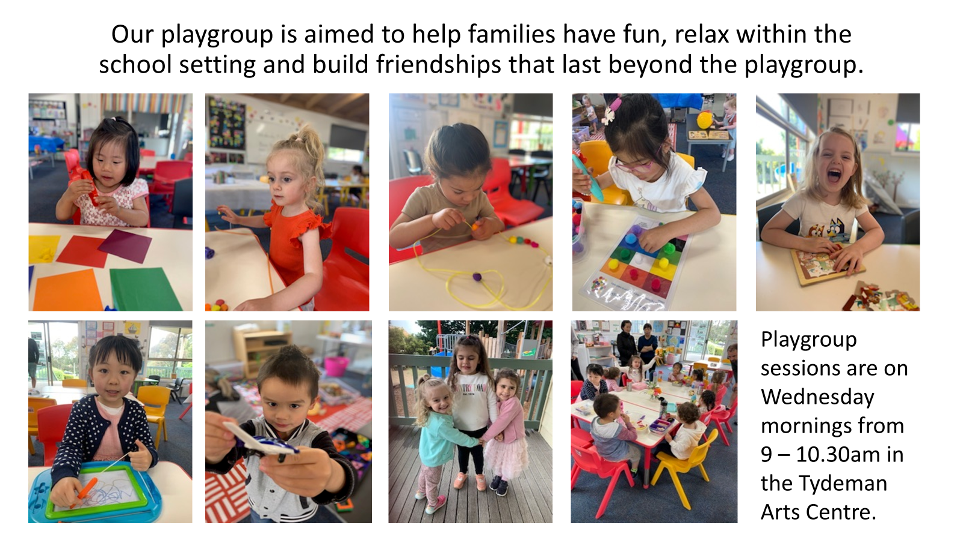

Slide 27
Thank you
Question & Answer time

