Slide 1
Level 3/4 Information Evening 3CB – Michelle Cohen-Beavis 3L– Hayley Lonsdale
3KR – Aggie Kurzak-Reeves 4F– Sarah Fortune 4J – Ash Jacobs Educational Support Staff Andy Pullar Chrissie Sandford-Ricci Fiona Schwass Jo Hewett Sienna Bett

Slide 2
We use Compass as a means of communication between classroom teachers and parents.
If you would like any further information about Compass, see the Office.
Please check Compass regularly for
upcoming events and to log absences
School Newsletter - available from school website and notification on Compass.

Slide 3
Smart watches and mobile phones
ALL mobile phones and smart watches need to be locked in safes in the Year 5 and 6 portables. Phones are not to be used on school grounds.

Slide 4
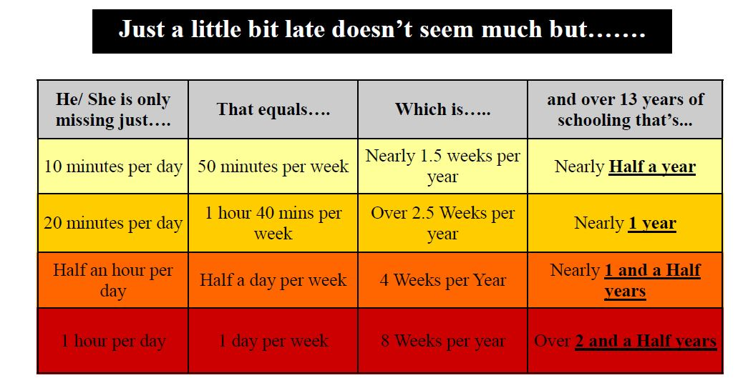
Attendance is important for your child's learning

Slide 5
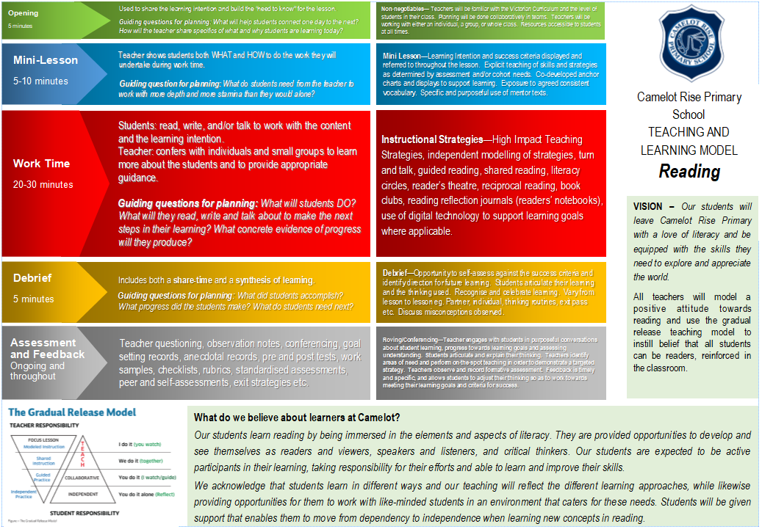
CRPS Instructional Model

Slide 6
LITERACY

Slide 7
How we teach reading?
All lessons follow the CRPS Instructional Model and Gradual Release of Responsibility
Developing a love of reading
Reading a rich variety of quality literature
Independent reading/reading to self
Explicit teaching of reading strategies
Using a variety of instructional methods:
Shared reading
Modelled reading
Think Aloud
Conferencing and individual goal setting
Strategy groups and Guided Reading groups
Tracking thinking - Students are also required to track their thinking at different times and are taught a variety of ways in which to do this.

Slide 8
How we teach writing? All lessons follow the CRPS Instructional Model and Gradual Release of Responsibility
Handwriting Typing Spelling Grammar
Methods of instruction:
Modelled writing
Shared writing
Conferencing
Purpose for writing:
to entertain
to persuade
to inform/explain
Writer’s Notebooks
Writing seeds and ideas
The writing process:
Pre-writing
Drafting
Revising
Editing
Evaluate
Publishing

Slide 9
Speaking & Listening
Classroom and Specialist opportunities:
Shared reading
Conferencing
Whole class/small group discussion
Circle time
Small group work
Formal upfront presentations
Pair discussion

Slide 10
How do we teach Maths?
All lessons follow the CRPS Instructional Model and Gradual Release of Responsibility
Across Level 3/4
Across Level 3 and 4 Maths classes change throughout the year depending on each student’s point of need across the different areas of mathematics. This means that the concepts being taught match each student’s needs and are grouped with other like-minded students
Pre and post testing using Essential Assessments
Students work in a variety of ways - aiming to build upon all 4 areas of mathematical thinking: understanding, fluency, reasoning and problem solving
Use a variety of concrete materials
Mathletics

Slide 11
Inquiry
We will cover curriculum areas including:
History
Geography
Civics and Citizenship
Design and Technologies
These units will often link with literacy such as non-fiction reading and writing.
Involve 1-2 sessions a week.
Students will have the opportunity to work independently, pairs, groups and across the 3/4 year levels. These units will often link with Literacy.

Slide 12
Digital Devices
What DT with devices looks like at Level 3/4:
Safe computer usage – including Cyber Safety and how to use different types of technology safely
All computer usage at school is supervised and structured to enhance student learning
Learning to use a range of devices, including cameras, netbooks and iPads
Learning how to create, store, save and retrieve files correctly
Using Microsoft Office programs (e.g. Word, PowerPoint, Publisher and Excel) to present ideas and learning
Developing research skill with the use of technology

Slide 13
CRPS Whole School Wellbeing Program
School values – Respect, Resilience, Responsibility
School Wide Positive Behaviour Support Framework
Wellbeing program focus
relationships
how to make and keep friends
social skills for the playground
teamwork
resilience
Respectful Relationships and The Resilience Project
Circle Time
Digital Wellbeing (eSmart)
Lunchtime activities & Buddy Bench corner, Wellbeing Captains, Peer Mediators

Slide 14
Seesaw
This is our student to parent communication portal.
Students share snapshots of their work throughout the year, covering a variety of subjects and classes.
If you aren’t already connected to Seesaw, you will get an email shortly asking you to join seesaw. Once you do this, you will be able to see any work your child has added. You will be able to leave a comment for them, if you wish.
Once signed up, you will receive an email whenever something new gets posted.
You can expect 4-5 pieces of work per term.

Slide 15
Homework
All students will receive a new student journal to keep track of their homework.
Homework is set/given out on a Monday and returned on Friday.
The homework expectations for students in Levels 3/4 are:
Reading 4 times a week (recorded in their diaryl)
Tasks from the journal which will have a wellbeing focus (optional)
A Maths revision sheet or Mathletics
The main purpose behind homework is the building of time management skills.

Slide 16
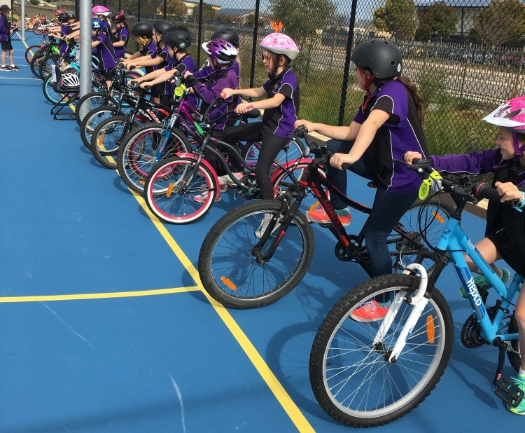
Excursions / Incursions Term 1 Level 4 - Bike Ed Term 3 Level 3/4 - Sleepover
WWCC
If you would like to be a parent helper, please ensure you have a working with children check and a copy is provided to the Office.

Slide 17
Other School-based Activities
Optional School-based Activities
NAPLAN (Level 3) – 12th to 24th March. Online this year except for Writing
Swimming Trials
Twilight Sports - Term 1
Cross Country
Athletics
Swimming Lessons – Term 4
Chess, Choir, Science Talent Search, ICAS, Premiers Reading Challenge

Slide 18
Specialist Programs
French - Rosemary Thom (Mon-Weds)
Performing Arts – Deb Hong
PE and Sport – Cameron Stillman (Tues-Fri)
STEM – Lorna Vinar (Mon,Tues,Wed,Fri)
Visual Arts – Sharyn Newstead (Mon-Thurs)
Tutoring - Sarah Martin (Tuesday & Wednesday)
The term focus for each specialist will be communicated in the We are Learning Boards which will be sent to Parents.

Slide 19
STEM
For Level 3/4 the STEM program will operate on a 2-year cycle. This year the students will cover Physical Sciences and Earth and Space Sciences. Next year the program will cover the Chemical and Biological Sciences.
· Throughout the year students will discuss their hypothesis and the aim of experiments and identify variables. Students will discuss independent and dependent variables.
· Students will use technology during experiments and apply mathematics skills they have learnt in class.
· In term 1 students will learn that a force can change the motion of an object and identify various forces including friction, magnetism, gravity and air resistance.
· In term 2 students will investigate how heat can be produced and transferred.
· In term 3 students will explore day and night. Students will learn about the moon, the earth and sun.
· In term 4 students will identify the layers of the earth and the impact of erosion and extreme weather events have on the earth.

Slide 20
FRENCH
In their French classes, students work equally on their speaking, listening, reading and writing skills, just as they do in their English classes. This term students are learning to talk and write about time and the things they do each day. The first few minutes of every class is spent revising standard questions like name, age, where they live, the date and the weather as well as beginning to apply current topics in partner conversations. This is designed to allow all students to experience success and to develop confidence with the language through repetition.
Written work adds the dimension of reading and writing to complement the oral and aural components.
A variety of formats is used to present content in order to reinforce concepts on the one hand and to create and maintain interest and motivation on the other.

Slide 21
PHYSICAL EDUCATION
The PE program emphasizes sportsmanship and fosters healthy, respectful competition, teaching students to appreciate both winning and losing.
The program focuses on three main areas:
1. Moving the Body
2. Understanding Movement
3. Learning through Movement
Students in Years 3 and 4 will continue to enhance their foundational motor skills, including bouncing, catching, hitting, throwing, rolling, and kicking.
They will explore the common elements found in major and minor games.
Fitness assessments in Terms 2 and 4 are an integral part of the curriculum. These assessments provide students the opportunity to analyze their results, reflect on their health and well-being, and introduce them to Cross Country and Athletics.
Students will begin to take on leadership roles while learning the basic rules and scoring systems of various sports and games.
Students can participate in Interschool sports, such as Cross Country, Athletics, and Swimming (age-dependent, they must be 9 years or older).
Students participate in weekly Intra-school sports, focusing on skill development and understanding the rules of specific games and sports. This prepares them for future Interschool sports in Years 5 and 6.

Slide 22
PERFORMING ARTS
PA encompasses Music, Dance and Drama. The students perform, create and respond as performers and audience. In Music they engage in listening and singing, games and body percussion, and use an assortment of tuned and untuned instruments including the recorder. They look at elements such as: beat, rhythm, pitch, dynamics, tempo, texture, form, harmony and melody, and compose with formal and informal notation. In Drama students act impromptu and with short scripts, and in Dance learn a variety of choreographed routines. Notable events include the Soiree and Christmas Concert. Students from 3-6 may join the Choir which meets on Friday during the 1st half of lunch time.

Slide 23
VISUAL ARTS
Students explore how artists, craftspeople, and designers bring ideas to life through various visual forms and processes, developing both conceptual and expressive skills. Through creating and responding to visual artworks, students delve into a variety of ideas, concepts, and perspectives. They draw inspiration from other artists, artworks, symbolic systems, beliefs, and visual arts practices across different cultures, societies, and time periods. They further develop a range of skills across a variety of media, including pencil, paint, clay and textiles. Please ensure all students have a named art smock.

Slide 26
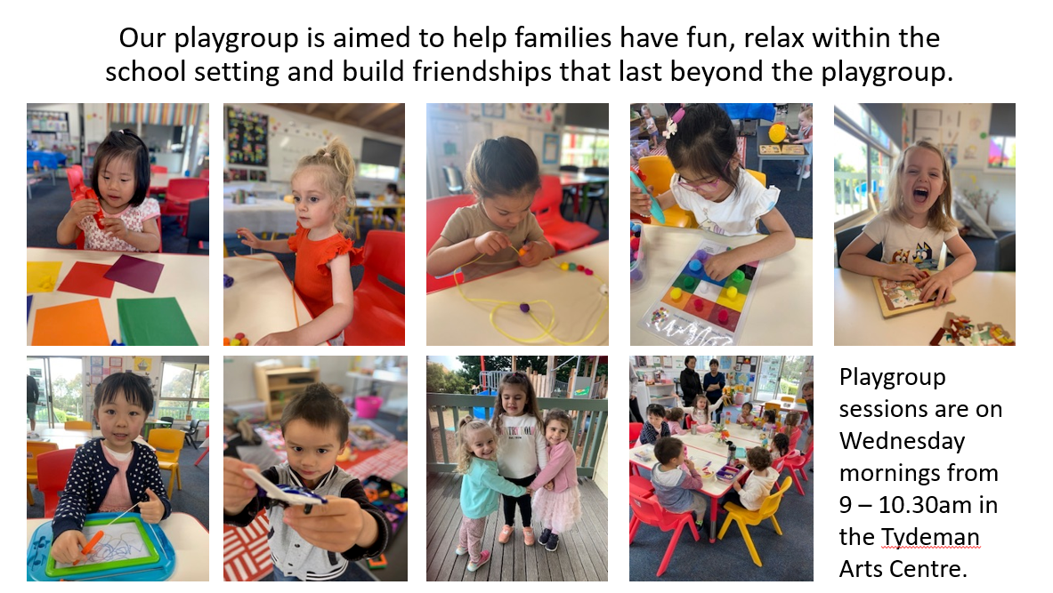

Slide 27
Question & Answer Time

